Slide 1
TVET: An Indispensable Tool for Sustainable Economic Prosperity and the Elimination of Discrimination
Everton Lewis, Ph.D.
University of Technology, Jamaica
March 31, 2022

Slide 2
OBJECTIVES of PRESENTATION
To address two primary questions, which will in essence cover the general topic of my presentation
To share some Jamaican experiences relevant to the topic
To examine some recommendations that relate to the topic

Slide 3
HOW DOES TVET PROMOTE SUSTAINABLE ECONOMIC PROSPERITY?
To increase the GDP (a measure of Economic Prosperity)
To increase Productivity levels we can:
Increase Labour Efficiency of the Labour Force
Increase the size of the Labour Force
Increasing the size of the existing work-force could include:
employing unemployed Females in non-traditional roles
employing unemployed Marginalised groups
employing unemployed Disabled Communities

Slide 4
HOW DOES TVET PROMOTE SUSTAINABLE ECONOMIC PROSPERITY?
TVET teaches us how to be wise consumers of Technology and its by-products
Technological Literacy
How to become Good Corporate Consumers and Citizens
Climate Change (i.e. Sustainability)
TVET promotes Sustainable Development
TVET promotes Economic Prosperity through:
Self-employment
Making one employable
Enabling Entrepreneurship (i.e. one may become an Employer)

Slide 5
HOW DOES TVET ELIMINATE DISCRIMINATION?
Discrimination is a ‘man-made’ prejudicial social construct
TVET as a discipline, is ‘Non-Discriminatory’
TVET prepares workers for employment and future job-skills in a Technology-based, Digital space
TVET teaches Skill Competencies
Hand AND Brain
TVET teaches Social and Emotional Learning (i.e. “Soft-skills”)
Self-awareness, Self-control, Coping- and vital Inter-personal skills

Slide 6
HOW DOES TVET ELIMINATE DISCRIMINATION?
TVET promotes Human Rights and mutual respect for others
TVET is “All-Inclusive” (incorporates all who can learn)
In TVET there is no room for the victimisation of:
Marginalised Groups (i.e. race, religion, political affiliation etc.)
Persons with Disabilities (PwD’s)
GENDER Bias
Gender is NOT a Disability – should never be perceived as such
Discrimination is reversible (with Education, over time)

Slide 7
Both Developed and Developing Countries…
Lack adequate numbers of skilled employees
And yet, we are not training our full potential workforce
Why not train girls in the skilled trades? (i.e. TVET)
Why not include competent Women for the workforce?
Ukraine is experiencing a “National Emergency”
Requires ‘drastic’ measures
Accepting FEMALE volunteers
Train them, arm them
They can be just as lethal as the men

Slide 8
The Jamaican Experience
Total Population: ~2.9 Million
Male population: ~1.5 Million
Female Population: ~1.4 Million
Working-age population (16 - 64 years): ~2 Million (70%)
Tertiary-level graduates: # Females > # Males
In the Workforce: # Males > # Females
“Leaking pipe” – we lose our females between school and work
“Gender discrimination” – females are not accepted in certain fields
“Glass ceiling” – females are employed, but are restricted

Slide 9
Mrs. Portia Simpson-Miller Former Prime Minister (2006-2007, 2012-2016)

Slide 10
Rear Admiral Antoinette Gorman-Wemyss Chief of Staff – Jamaica Defence Force

Slide 11
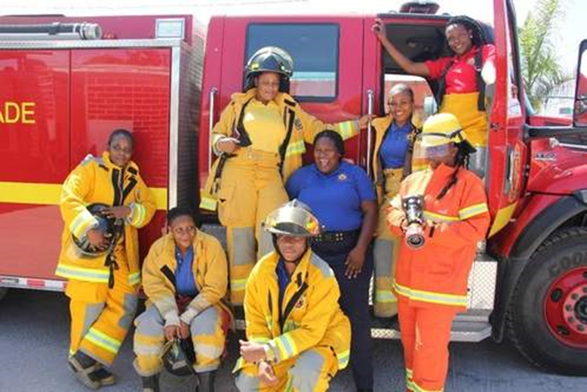
ALL-FEMALE FIRE FIGHTERS

Slide 12
Persons with Disabilities (PwD’s)
A ‘disability’ is a social construct
We should never exclude PwD’s from pursuing their job preferences
It is their ‘human right’ to choose (within their limitations)
Most efficient switchboard operator
My Lab. Technician
Licensed Electrician
“Mr. Fix it”
“Blind” Cricket teams, “Blind” Soccer teams

Slide 13
Blind Computer Repairman (Jamaica)
Anthony Whyte works on a PC at his home in Clarendon

Slide 14
Photo courtesy of: One hand and one leg - ... but … stands tall as mechanic and electrician | News | Jamaica Star (jamaica-star.com)

Slide 15
Senator Dr. Floyd Morris – President of the Senate

Slide 16
TVET: The Indispensable Tool
TVET is the “T” in STEM / STEAM
TVET produces your Technicians, Technologists, and Engineers
There is a stigma against TVET (as if all ‘hands’ and no ‘head’)
Educational system – Teachers and Guidance Counsellors
Society - stigma
Parents - ego
The world is now responding to the importance of TVET
TVET needs to re-brand itself as a legitimate and relevant discipline

Slide 17
What Can TVET Do?
In developing countries, there are exorbitantly high levels of unemployment and under-employment
Economies globally are greatly in need of skilled labourers
TVET can drive social and economic progress, and enhance international competitiveness
Resulting in Poverty Alleviation
Contributing to National Development
TVET can remove social barriers (e.g. gender discrimination)
TVET can remove stigmas (e.g. disability discrimination)

Slide 18
THE TYPICAL EDUCATION SYSTEM
Policy Framework (Governments)
Benchmarks/Standards (MoE/Stakeholders)
OBJECTIVES (School/TVET Teachers)
CONTENT
EVALUATION
TEACHING METHODOLOGY

Slide 19
The Policy Makers
In 2007 Jamaica signed and ratified the Convention on the Rights of Persons with Disabilities (CRPD).
“Nothing about us, without us” – adequate representation
Social inclusion
Must Act with urgency
The Disabilities Act (2014) – passed into Law - February 14, 2022

Slide 20
WHAT SHOULD GOVERNMENTS DO?
Acknowledge the importance of TVET to National Development
Provide job-market data (i.e. current and future Needs Analyses)
Promote the use of technology to enhance the learning experience
All educational institutions must have quality internet facilities for all
Promote Distance Learning methodologies, if needed
Ensure that all training facilities are accessible to all students
Develop “well rounded,” employment-ready, competent individuals
Provide adequate, efficient, and equitable financing for education

Slide 21
TVET Needs ‘Equity’ and NOT ‘Equality’

Slide 22
Role of Ministry of Education & Stakeholders
Target females and the discriminated communities for recruitment
Ensure ALL facilities can accommodate PwD’s – mandatory
Special provisions for classes, labs., rest rooms, dining services, etc.
Provide accessible housing and/or transportation for PwD’s
Provide incentives for employers who retain females and PwD’s
Provide support services for females and PwD’s to identify jobs
Preventative services: information on disability prevention
Restorative services: assistive devices, medical interventions
Rehabilitation services: Self- and Social enhancement
Psychological services: counselling, career guidance, etc.

Slide 23
Role of TVET Teacher-Training Institutions
Review Curriculum periodically – ensure its relevance
Actively recruit females and persons with disabilities
Remove sexist language from Curriculum, instructional materials
Have ALL students learning together (i.e. integration)
Train ALL teachers to meet needs of females and PwD’s
Be sensitive, adaptable to meet their learning needs
Introduce basic Sign Language, Braille resources, etc.
Prepare more teachers in Special Education
They can guide and mentor other teachers
Provide continuous professional development for ALL Teachers

Slide 24
The TVET TEACHER/FACILITATOR
Research has consistently shown that the Teacher/Facilitator is critical to an effective teaching/learning system
Should employ research-based, proven pedagogies
Should acquire relevant work experiences
Should be passionate about their responsibility

Slide 25
RECOMMENDATIONS
TVET must be fully integrated into the traditional school curriculum
TVET must be aggressively re-branded as a viable career path
Must improve the quality of training delivery
Re-tool and re-train TVET teachers and instructors (highly competent, qualified, motivated, creative, adaptable, etc.)
Teachers/instructors must be directly involved in this reformation
TVET needs to be given adequate human and financial resources
TVET must promote entrepreneurial development

Slide 26
RECOMMENDATIONS
TVET disciplines must be open to female students
TVET must cater for students with various disabilities
They can contribute towards economic and social development
TVET institutions must partner with local industry players
Authentic learning, internships, advice, support etc.
TVET institutions must certify the competent, informally-trained
TVET must promote itself as a life-long learning process
Develop both technical and ‘soft’ skills
For self-improvement and national development

Slide 27
SUMMARY/CONCLUSIONS
If Education is a ‘Key’ to:
Sustainable Economic Development and Prosperity
Removing Gender and Disability Discrimination
TVET is a “Master Key” – an indispensable tool

Slide 28
Further Readings
Subrahmanyam, G., (2020). Trends mapping – Future of TVET teaching. UNESCO- UNEVOC International Centre for Technical and Vocational Education and Training. Retrieved from trendsmapping_futureoftvetteaching.pdf (unesco.org) on March 14, 2022.
MacDonald, S., Nink, C., and Duggan, S., (2010). Principles and Strategies of a
Successful TVET Program. MTC Institute. Retrieved from Principles-and-Strategies-of-a-Successful-TVET-Program.pdf (mtctrains.com) on March 22, 2022.
Nwachukwu, P., (2014). Poverty Reduction through Technical and Vocational Education and Training (TVET) in Nigeria. Developing Country Studies Vol.4, (n)14. Retrieved from 14361 (iiste.org) on March 19, 2022.
UNESCO, (2016). Recommendation concerning Technical and Vocational Education and Training (TVET), 2015. Retrieved from Recommendation concerning Technical and Vocational Education and Training (TVET), 2015 – UNESCO Digital Library on March 5, 2022.

